Slide 1
Unlock the power of the digital economy
Presented to <Company Name>
<Date>
Notes:
Thank you for meeting with us today.

Slide 2

Businesses must rely on technology and ecosystems to scale and evolve
THE DIGITAL ECONOMY DRIVES GROWTH AND SOCIETAL PROGRESS
    Business opportunity starts where your customers are.
    Business and technology are now inseparable.
    Digital ecosystems are growing at an exponential scale.
    Data explosion and AI are driving change.
    Sustainability is now mission-critical.

Slide 3
Spending on digital technology by organizations will grow at 7x the economy in 2024, as companies are compelled by market demands to grow digital business models and strengthen digital capabilities.
“IDC FutureScape: Worldwide Digital Business Strategies 2024 Predictions,” IDC, October 2023.
Notes:
According to the Gartner 2023 Board of Directors Survey, 89% of boards agree that digital is an implicit part of growth strategies. 12-key-findings-from-the-gartner-2023-board-of-directors-survey.png (750×900) (gartnerweb.com)
By 2028, most organizations will fully transform into digital entities capable of sensing and responding to business and market conditions. Organizations are actively investing in cloud technology due to its potential to foster innovation, create market disruptions and enhance customer retention in order to gain a competitive edge. Gartner Says Cloud Will Become a Business Necessity by 2028
Digital business leaders are seeing faster innovation, higher productivity and efficiency, and increased digital infrastructure uptimes while building more resilient organizations. IDC's Digital Business Scorecard shows that leaders are seeing significantly better business outcomes in important areas such as customer satisfaction and sustainability. IDC Digital Business Scorecard, 2023: Empowering Enterprises to Achieve Business Outcomes
Over the past three years, the spread in digital and AI maturity between leaders and laggards has increased by 60 percent. Rewired companies build capabilities that build on each other so that, over time, value compounds—more value, more speed, more digital distance over peers. https://www.mckinsey.com/capabilities/mckinsey-digital/our-insights/ten-unsung-digital-and-ai-ideas-shaping-business
Almost every large business has embarked on some type of digital and AI transformation, and 47 percent of companies in the top decile have seven or more leaders who are fluent in tech. Companies should not only be focusing on how to integrate a specific technology, such as gen AI or quantum. Instead, they should concentrate on building the broad set of capabilities—strategy, talent, agile operations, technology, data, and adoption and scaling—that can harness new technologies, scale them and ensure they create value. https://www.mckinsey.com/capabilities/mckinsey-digital/our-insights/ten-unsung-digital-and-ai-ideas-shaping-business
Spending on digital technology by organizations will grow at 7x the economy in 2024, as companies are compelled by market demands to grow digital business models and strengthen digital capabilities. IDC FutureScape: Worldwide Digital Business Strategies 2023 Predictions
In 2028, organizations with established digital business platforms will have 50% higher digital market share with greater abilities to track ROI and execute digital revenue initiatives. IDC: Digital Technology Spending by Asia/Pacific* Organizations to Grow at 5X the Economy in 2024
By 2027, 80% of CEOs will assert that their C-suite technology leader’s primary function should be to invest in digital-first initiatives to deliver on digital revenue targets. . IDC: Digital Technology Spending by Asia/Pacific* Organizations to Grow at 5X the Economy in 2024
Value will accrue to businesses that have proprietary data that they can use to improve the capabilities of their foundation models in ways their competitors can’t. Data products can deliver new business use cases as much as 90% faster and reduce the total cost of ownership by 30 percent. https://www.mckinsey.com/capabilities/mckinsey-digital/our-insights/ten-unsung-digital-and-ai-ideas-shaping-business

Slide 4

Here’s why businesses are embracing a digital-first approach
DIGITAL OPPORTUNITY
    To create and provide digital services.
    To participate in digital ecosystems that offer new skills
    and capabilities.
    To use emerging technologies that drive innovation and
    real-time insights.
    To tap into digital infrastructure committed to sustainability, creating new value.
Notes:
Infrastructure committed to sustainability allows businesses to meet compliance and regulatory standards—as well as societal objectives.

Slide 5

Digital-first strategies power the future
Businesses are using digital-first strategies to grow sustainably
For companies with a digital-first approach, business, technology and sustainability go hand in hand.
    Build a strong digital infrastructure to create and offer new digital services.
    Participate in multiple ecosystems to create new value.
    Use real-world data and AI to drive innovation.
    Choose like-minded partners to help achieve sustainability goals.

Slide 6
Digital infrastructure enables you to meet challenges and pursue possibilities
Exploding data
volumes
  181 ZB
  of data in real time by 2025
Fast-growing
AI market
$6.2B
  in 2023 to $16.2B by 2028
Ecosystems
era
  60%
  reduction in data transfer costs among ecosystems partners
Cloud-Neutral Storage
at Equinix
  67%
  lower cost to deliver storage and data services
Notes:
Source: ESG – Analyzing the Economic Benefits of Equinix Cloud Adjacent Storage | Analyst Reports

Slide 7
New opportunities with technology adoption
TECHNOLOGY ADOPTION
ENABLES SCALE AND INNOVATION
Composable
business
  Subscription businesses have grown 4.6x faster than the S&P 500 in the last 10 years.
Emergence of
AI ecosystems
  By 2025, 40% of organizations will include on-demand services powered by AI.
Specialized
compute
  Quantum computing market size is projected to grow to $6.5 billion by 2030.
5G to scale end-point demand
  Global 5G services are projected to grow at a 59.4% CAGR from 2023 to 2030.
Notes:
The Subscription Economy Is Set to Grow To $1.5 Trillion by 2025 — https://sellcoursesonline.com/subscription-economy-statistics
Emergence of AI ecosystems
By 2025, 40% of organizations will be selling to, engaging with, or provisioning on-demand services through digital ecosystems to enable new business models powered by AI everywhere capabilities. IDC FutureScape: Worldwide Digital Business Strategies 2024 Predictions - Printer-friendly - US50120323
96% of executives agree leveraging AI agent ecosystems will be a significant opportunity for their organizations in the next 3 years: https://www.accenture.com/us-en/insights/technology/technology-trends-2024?c=acn_glb_accenturetechnogoogle_14070969&n=psgs_0124&gad_source=1&gclid=Cj0KCQiAoKeuBhCoARIsAB4WxtdN6A9Lma2f3rYekM1VWQIwscff-bUvMWECMcxg1Aa7HkA16py1FjkaAoNYEALw_wcB&gclsrc=aw.ds#block-meet-my-agent
Specialized compute
The quantum computing market size is projected to grow from $928.8 million in 2023 to $6,528.8 million by 2030, at a CAGR of 32.1%. Read More at: Quantum Computing Market Size, Value | Growth Analysis [2032] (fortunebusinessinsights.com)
5G to scale end-point demand
The global 5G services market size was valued at US$84.31 billion in 2023 and is projected to grow at a compound annual growth rate (CAGR) of 59.4% from 2023 to 2030. 5G Services Market Size, Share & Trends Report, 2030 (grandviewresearch.com)

Slide 8

Trends in AI
PRIVATE AI IS DEFINING A NEW MARKET
    AI is transitioning from experimental to a diverse
    set of real use cases.
    The hybrid AI market is shifting to private AI.
    Private AI is tackling security, data leakage, privacy, regulatory and sustainability challenges.
    Businesses are investing in AI for valuable insights
    and intelligent business decisions.
    The surge in use places further pressure on
    IT Infrastructure.
    There is growth in the customization of AI models based on private data, which requires less power.
The global explainable AI market is forecast to grow from
$6.2 billion in 2023 to $16.2 billion by 2028.
Notes:
The global Explainable AI Market size is projected to grow from US$6.2 billion in 2023 to US$16.2 billion by 2028.
"By 2026, the proliferation of data from GenAI and other key digital initiatives will result in 25% of the G2000 organizations introducing or elevating the role of chief AI officer to the C-suite."

Slide 9

Trends in multicloud networking
MAXIMIZING THE POTENTIAL OF A MULTICLOUD APPROACH
    Businesses are embracing multicloud as part of
    their cloud strategy.
    Complexity is increasing with the growth of network management between private and public clouds.
    Organizations are using multiple cloud providers for flexibility, operational simplicity and global coverage.
    More companies are moving to a multicloud
    environment to reduce latency and time-to-market.

Slide 10
Strengthen your leadership position
Make digital infrastructure more powerful,
accessible and sustainable.
Notes:
So how do you get started on the path to accelerate your digital advantage?
First, make sure you architect the right infrastructure.
An IOA enables a digital infrastructure that interconnects digital services with ecosystems in proximity to where business matters.
Next, ensure it is architected on the best platform—Platform Equinix.
Platform Equinix offers a combined set of assets and capabilities on a global interconnection platform, which readily enables the exchange of value among ecosystem participants leveraging IOA strategies for businesses.

Slide 11
Over one-third of IT leaders said network optimization improvement, boosting flexibility of connectivity and aiding digital transformation were among the leading benefits of interconnection.
Equinix 2023 Global Tech Trends Survey
Notes:
Source: Equinix 2023 Global Tech Trends Survey | Equinix infopaper

Slide 12
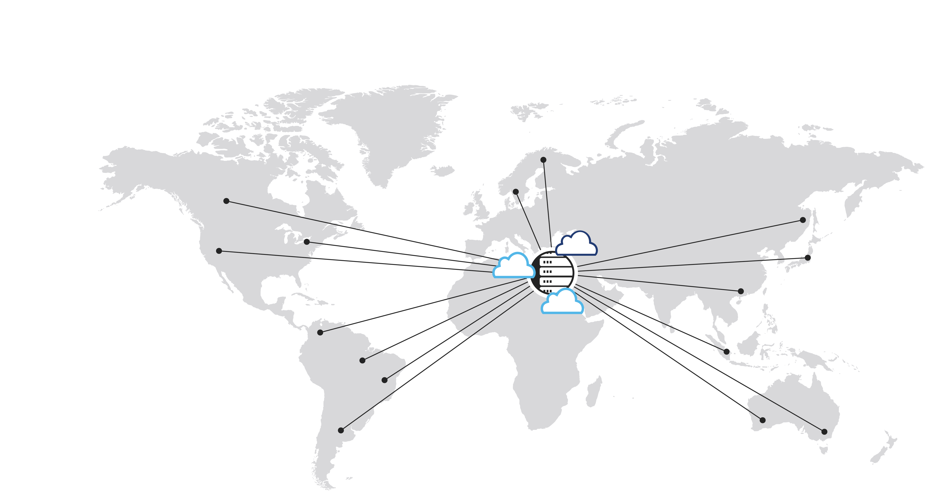
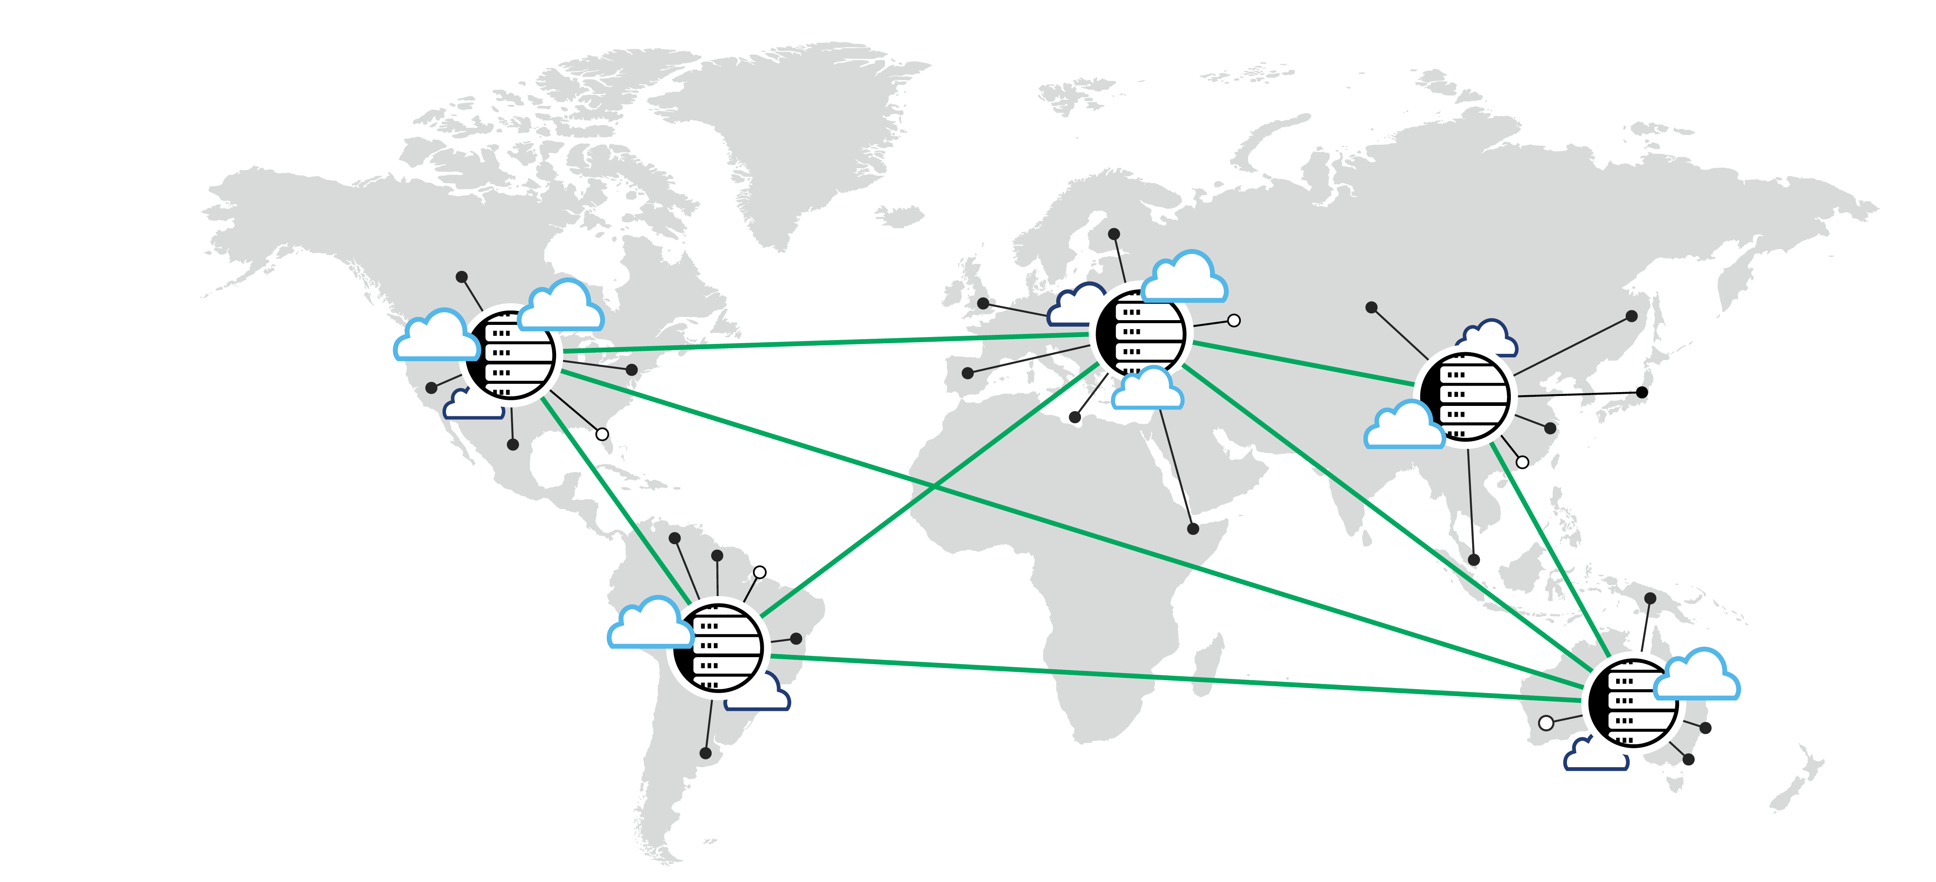
The most efficient way to exchange data​
Economics of data
Localized exchange to reduce costs
Economics of time
Highest volumes with lowest latency
Figure 1. Siloed and centralized
Economics
of density
Proximity to networks
and cloud majority
Economics
of experience
Shortest distance
to populations
The most efficient way to exchange data:
Interconnection Oriented Architecture® (IOA®)
Figure 2. Distributed and interconnected
Notes:
Digital services require continuous electronic data exchange across multiple partners.
Business leaders have shown us that as soon as your business needs to solve for the economics of digital, interconnection is inevitable.​
The economics of data, density, velocity and experience demand localized exchange to move the highest volumes of data with the lowest latency to dense clusters of participants and population centers.

Slide 13

Interconnection helps businesses grow and scale in the digital economy
    Overcome complex, fragmented infrastructure
    spanning private and public environments.
    Place infrastructure in strategic locations.
    Access essential digital and business ecosystems.
    Simplify with software-defined, edge-to-cloud
    automated implementation and management.
Notes:
Today’s businesses struggle with complex, fragmented infrastructure sourced from multiple providers across private and public environments as well as multiple geographies.
They need help simplifying and integrating their infrastructure.
As the world’s digital infrastructure company, Equinix has built a trusted global platform that uses interconnection to connect foundational digital infrastructure components required to achieve digital advantage.
An Interconnection Oriented Architecture (IOA) enables a digital infrastructure that interconnects digital services with ecosystems in proximity to where business matters. Digital leaders easily move into new markets, shift capacity where needed, add/reduce capacity to support revenue growth, etc., all with low risk and a localized advantage. It’s not surprising why IOA has been such an enduring architecture in these times of rapid digital business change.

Slide 14
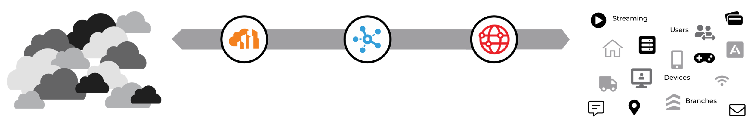
GXI 2024 reveals businesses follow the same steps to fast-track digital transformation
Businesses are using a digital platform to build architecture that enables access to all required resources. This is the foundation for efficient digital scale and maximizing the capabilities of AI. ​
Participant density
Digital core
Digital ecosystem
Digital edge
Population centers
Core: Proximity to the greatest cloud and network density
Ecosystems: Proximity to the largest number of partners, communities and marketplaces
Edge: Proximity
to where business happens
Notes:
There are three distinct layers in the platform—the core, the ecosystem, and the edge—where the benefits of our sustainability program and the combined strength of our partners’ sustainability investments show up.
Starting from the bottom:
For the core, businesses can access a global and sustainable infrastructure platform from anywhere.
For the ecosystem, they can easily and seamlessly connect with the largest choice of climate-focused partners and suppliers who have a shared commitment to optimizing their business and environmental outcomes.
And coming to the top, building on sustainable foundation and ecosystem, businesses can unlock opportunities at the edge to offer their own sustainable services to customers in the verticals that they serve.

Slide 15

Interconnection to multiple business partners is key to success
At each strategic location (hub), interconnection is used in multiple ways.
Cloud and IT providers are connecting to networks.
This illustration represents a typical colocation hub.​
Enterprises are connecting
to cloud providers.
Networks
are connecting
to network providers.
Financials are connecting with each other.
Notes:
Digital businesses have discovered that it is impossible to process the exponentially growing volumes and variety of data without interconnecting to multiple business partners. At each strategic location (hub), interconnection is used in multiple ways.

Slide 16
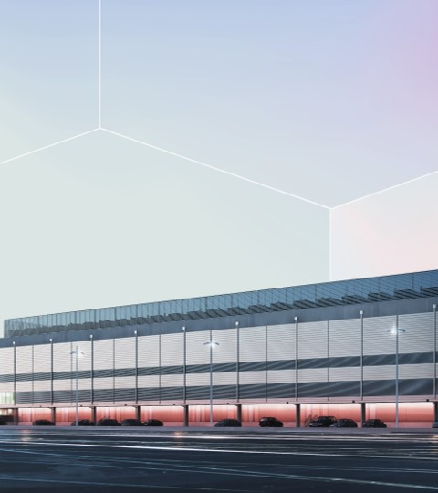
Private AI at Equinix fuels your growth
EQUINIX: WHERE PRIVATE AI HAPPENS
    Scale your AI maturity by leveraging digital infrastructure that gives you:
      Access to a rich ecosystem of companies.
      Cloud neutrality.
      Global interconnected data intake locations.
      Strategic partnerships with leading AI infrastructure providers.
    Simplify your multicloud with secure, high-speed access to cloud providers, data brokers and their AI models.
    Gain a robust foundation covered by 100% renewable energy designed for global scale.

Slide 17
Optimize multicloud connectivity
Multicloud networking at Equinix
simplifies your journey
    Overcome key challenges associated with applications distributed over multiple environments.
    Get the lowest possible latency to AWS®, Google Cloud™, Microsoft Azure® and Oracle Cloud® with Equinix’s cloud adjacent locations in numerous markets across the globe.
    Easily deploy private connections with less reliance on the public internet.
    Integrate with private clouds; data center deployments; and Equinix digital storage, network and compute services, with the ability to evolve as requirements change.
    Gain operational efficiency by streamlining multicloud network deployments.

Slide 18
Equinix is the world’s digital infrastructure company®
Notes:
Equinix is the world’s digital infrastructure company.
We believe digital infrastructure should be your greatest source of competitive advantage.
But to get there, you need one place to bring together and interconnect the foundational digital infrastructure components needed to power your success.
Combine all the right places, partners and possibilities on a single global platform.

Slide 19
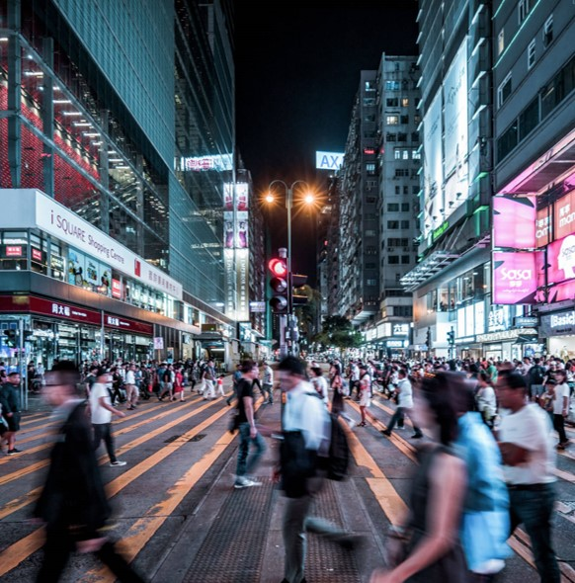
Enduring purpose.
Everyday actions.
OUR PURPOSE
  Our purpose is to be the platform where the world
  comes together, enabling the innovations that enrich
  our work, life and planet.
Notes:
[NOTE TO PRESENTER: Before meeting with customers/partners, understand their organizational purpose so you can discuss how Equinix’s purpose aligns with theirs; if they don’t have a stated purpose, look up their mission/vision to identify their highest aspiration as a company.]
As a company, we care passionately about leaving the world a better place.
We are guided by our purpose to be the platform where the world comes together, enabling the innovations that enrich our work, life and planet.
This fuels us to do everything we can to help you succeed.
Because we know that if you’re able to find everything and everyone you need to innovate on our global platform, you’ll be able to create innovations that matter—with the power to enrich how we all work, live and protect our planet.
We want to understand what drives our customers and how we can help advance their highest and best ambitions.
I understand that your [Purpose/Vision/Mission] is to [fill in what you learned from your research].
Can you tell me a little about what is most important to your organization and team? How can we help you achieve that?

Slide 20

Making digital infrastructure more powerful, accessible and sustainable
OUR MISSION
  On Platform Equinix®, digital leaders bring together all the right places, partners and possibilities to create the foundational infrastructure they need to succeed.
Notes:
Equinix is helping digital businesses assemble infrastructure in mere minutes to build digital advantage, boost agility and accelerate deployment. As technology trends intensify the need for digital infrastructure, an interconnected approach helps businesses to deliver new capabilities for the digital world.
Building a digital infrastructure with a single location ensures:
Foundational infrastructure to reach all the right places
Access to vendors, best-of-breed providers, regional specialists and innovative new entrants
Accelerated delivery and consumption of digital services at global scale

Slide 21
Place infrastructure wherever you need it
ALL THE RIGHT PLACES
Broad selection
Choose from physical and virtual distributed building blocks across network, compute and storage capabilities.
Global footprint
Leverage 260+ data centers across 73 metros in 34 countries on 6 continents.
Software-defined interconnection
Deploy Equinix Fabric® for global reach and
on-demand cloud and network services.
Sustainability leader
Partner with the first data center company to commit to 100% clean and renewable energy coverage.
Notes:
ALL THE RIGHT PLACES
Select physical and virtual distributed building blocks across network, compute and storage capabilities.
We’ve built the industry’s largest global footprint of 260+ data centers across 73 metros in 34 countries on 6 continents.
With a software-defined interconnection platform, enterprise IT organizations no longer need to maintain multiple networks, end-point security and VPN licenses, or hardware, as they can all be found in one place.
Equinix is a recognized sustainability leader and was the first data center company to commit to 100% clean and renewable energy coverage.
This means you can:
Locate adjacent to the public clouds and networks to create best-of-breed hybrid multicloud architecture.
Build physical or virtual infrastructures on the industry’s most consistent, secure and sustainable platform.
Deploy in proximity to the customers, geographies, and locations that matter to your business for low-latency performance.

Slide 22
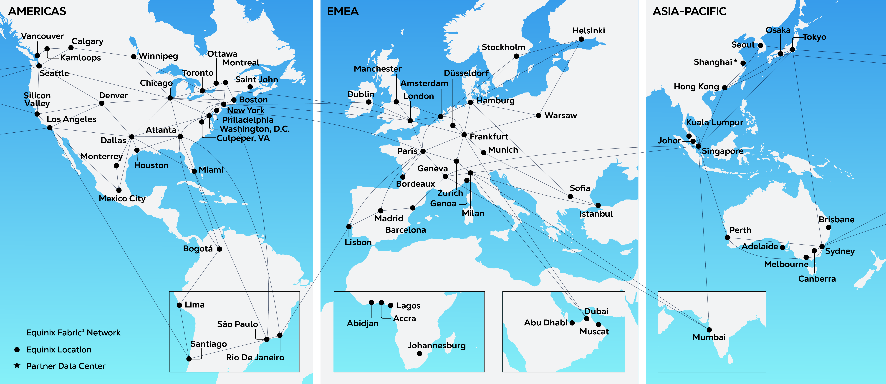
260+ | 73 | 34 | 99.999%+
Data centers | Metros | Countries | Uptime record*
*As measured from Jan. 1–Dec. 31, 2023, for International Business Exchange™ (IBX®) operations
Notes:
The world’s most expansive, secure and sustainability-focused data center platform.
Equinix owns and operates a network of 260 International Business Exchange™ (IBX®) and xScale® data centers located in 73 major metros around the world to make interconnection easy.

Slide 23






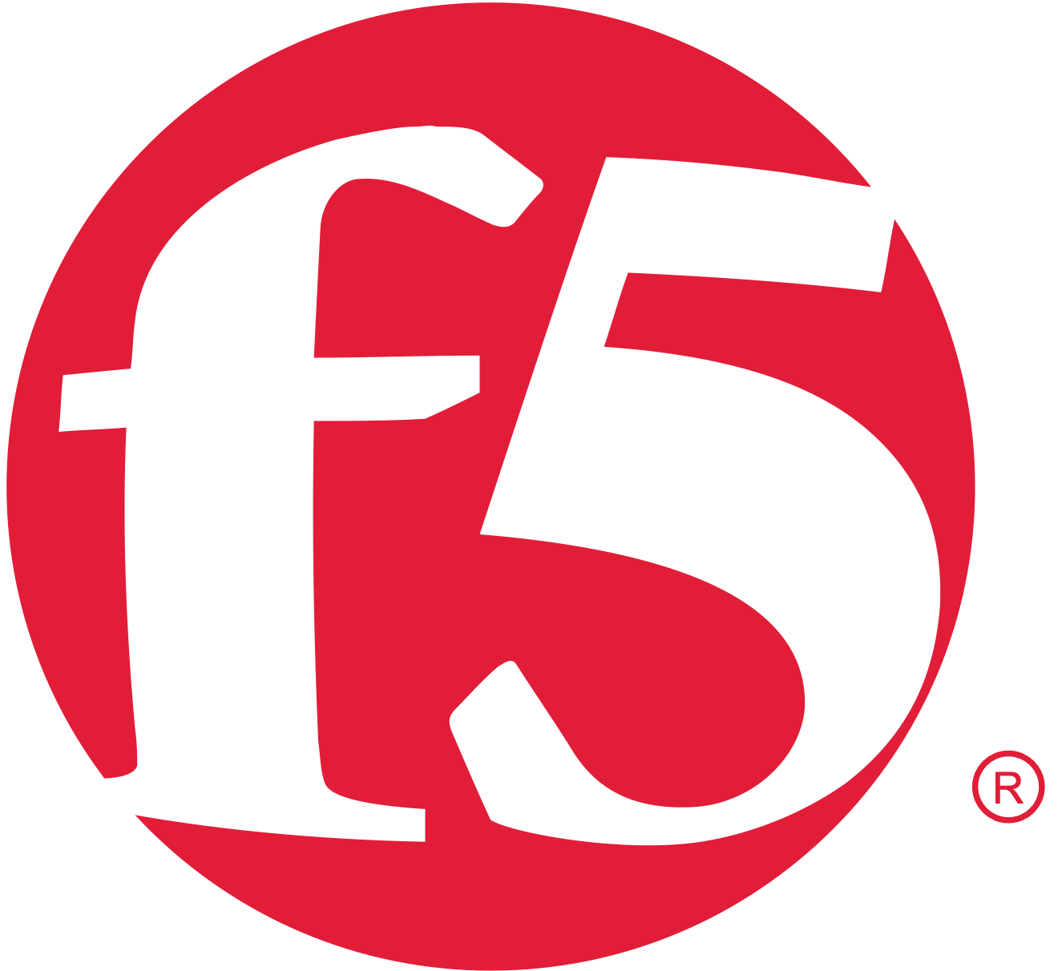







Connect to everything you need to succeed
ALL THE RIGHT PARTNERS
Diverse global ecosystem
Access the largest and most dynamic global ecosystem
with 478,000 interconnections.
Enterprises and service providers
Select from ~2,000 networks, 4,800+ enterprises
and ~3,000+ cloud and IT service providers.
Interconnection opportunities
Discover and transact with customers, suppliers
and partners to create and consume new value.
Digital capabilities
Unlock new capabilities with software-defined
connectivity to thousands of partners and providers.
Notes:
ALL THE RIGHT PARTNERS
We offer a global ecosystem of 10,000+ companies, including ~2,000 networks and ~3,000 cloud and IT service providers.
These businesses are adding new connections to one another faster than the next 10 providers combined.
An award-winning portfolio of physical and virtual interconnection services including the ubiquitous, global reach of Equinix Fabric (software-defined interconnection) ensures easy access to this dynamic global ecosystem of enterprises and service providers.
Unlock new capabilities with software-defined connectivity to thousands of partners and providers.
This means you can:
Choose current vendors, best-of-breed providers, regional specialists or innovators from the industry’s largest ecosystem.
Connect in real time, directly and privately, to thousands of partners for increased performance, security and scale.
Transact with ease. Supply, consume and integrate networks, storage, compute and applications over a single orchestrated interconnection fabric.

Slide 24


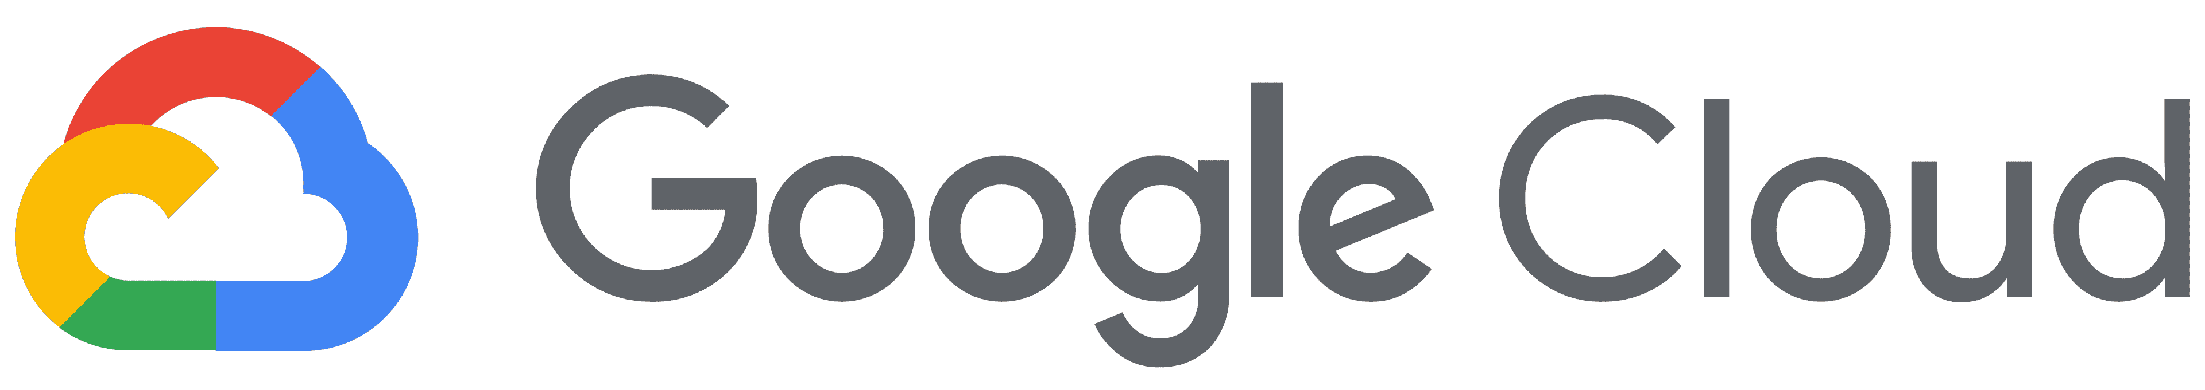



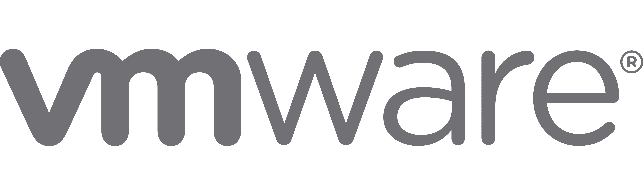







Everything works better together on Platform Equinix®
SaaS
Internet
Edge
Services
Digital
Supply
Chain
Equinix Fabric®
via Platform Equinix®
IaaS
Network
Services
Colocation
Security
Services
Notes:
The world’s most expansive, secure and sustainability-focused data center platform.
Equinix owns and operates a network of over 260 International Business Exchange™ (IBX®) and xScale® data centers located in 73 major metros around the world to make interconnection easy.

Slide 25

Seize opportunities with agility, speed and confidence
ALL THE RIGHT POSSIBILITIES
Scalable infrastructure with software-like navigation
Infrastructure as flexible and easy to use as software—designed to grow with you.
Unparalleled global digital ecosystem
The largest platform to connect, transact and innovate with customers, suppliers and partners.
Dynamic, secure access everywhere
Seamless connectivity with no barriers—low risk, high reach and unlimited potential.
Trusted leader in sustainable practices
Proven reliability and innovation in all major markets, building trust through sustainability.
Notes:
ALL THE RIGHT POSSIBILITIES
Software-powered orchestration allows you to deploy on-demand, automated infrastructure building blocks for networking, storage and compute.
Leverage API integration and a robust DevOps toolset on an enhanced platform architecture.
Design and test digital infrastructure solutions with our global team of Solutions Architects and Professional Services experts in 19 Solution Validation Centers.
Benchmark your progress and accelerate it through proven best practices used by digital leaders and playbooks to guide your transformation.
This means you can:
Accelerate delivery and consumption of digital services at global scale with on-demand infrastructures.
Innovate by unlocking new capabilities with software-defined connectivity to thousands of partners and providers.
Trust in the support and professional advice of a global force of Solutions Architects and engineers dedicated to accelerating your leadership.

Slide 26





Equinix is uniquely positioned to help you move forward
Digital infrastructure
services
Interconnection
services
Network Edge
Equinix Fabric®
Data center services
Equinix Fabric
Cloud Router
IBX®
Data Centers
Leverage essential tools, technologies and capabilities
Enable your digital-first strategy with our portfolio of services—delivering agility, speed and high performance to meet your infrastructure needs.
Equinix
Internet Access
xScale®
Data Centers
Equinix
Internet Exchange
Equinix
Smart View®
Equinix
Cross Connects
Equinix
Smart Build
Equinix
Smart Hands®
Notes:
Our portfolio of products:
Digital infrastructure services
Digital infrastructure services enable customers to bring together physical and virtual technologies like compute, storage, network and applications to build a foundation for a company’s digital operations. They help businesses rapidly deploy as a Service networking, security and hardware across our global data center footprint as an alternative to buying, owning and managing physical infrastructure. A foundation that modern businesses are using to re-architect their services for digital delivery on a global scale.
Network Edge—Select, deploy and connect virtual network services at the edge in minutes, with no additional hardware requirements. Think of it as a virtual Performance Hub.
Interconnection Services
Interconnection solutions connect businesses directly, securely and dynamically on one global platform. A portfolio of services that enable customers to connect with their partners, services providers and other businesses.
Equinix Fabric—The world’s first real-time interconnection technology built especially for digital infrastructure. Businesses use Equinix Fabric to directly connect at global scale to their choice of thousands of networking, storage, compute and application service providers in the industry’s largest infrastructure ecosystem.
Equinix Fabric Cloud Router—Makes it easy to connect applications and data across different clouds. With high-performance and secure private connections, protecting data from exposure to the public internet, these enterprise-grade connections offer virtually unlimited bandwidth and built-in resiliency. Fabric Cloud Router also reduces networking costs, lowers cloud egress charges and enables elastic bandwidth consumption so customers pay for only what they need.
Equinix Internet Exchange—Enables networks, content providers and large enterprises to exchange internet traffic through the largest global peering solution. Service providers can aggregate traffic to multiple counterparties (“peers”) on one physical port and handle multiple small peers while moving high-traffic peers to private interconnections. This reduces latency for end users when accessing content and applications.
Equinix Internet Access—An agile, scalable, resilient and high-performing managed internet access solution. Offering multiple upstream Tier 1 providers per metro and connections to all Equinix and major third-party internet exchanges, with over 300 private peering relationships, it delivers superior availability and performance. Internet Access serves as a one-stop shop for businesses, offering both physical and virtual connection options with Equinix Fabric and Network Edge to deliver primary and secondary internet access solutions. Available in 60+ markets, Internet Access allows scalable bandwidth to meet growing usage needs, empowering businesses to innovate in the digital age.
Equinix Cross Connects—Provides a point-to-point cable link between two customers in the same Equinix IBX data center. They deliver fast, convenient, affordable and highly reliable connectivity and data exchange with business partners and service providers within the Equinix ecosystem.
Data Center Services
Our global, state-of-the-art data centers meet the highest standards of security, reliability, certification and sustainability. These constitute a suite of comprehensive services that provide all the components required by a customer to house its IT infrastructure (or equipment) and then to implement, operate and maintain its applications and related IT tasks such as storage, back-up & recovery, testing and management. We have over 260+ data centers in total.
IBX data centers—Equinix International Business Exchange (IBX) data centers are our vendor-neutral colocation data centers worldwide, which provide access to vital ecosystems where enterprises, network, cloud and SaaS providers, and business partners directly and securely interconnect to each other.
xScale data centers—xScale data centers serve the unique core workload deployment needs of a targeted group of hyperscale companies, including the world's largest CSPs. Hyperscalers require infrastructure to support demanding workload requirements for cloud and AI initiatives. With xScale data centers, hyperscale customers add to their core hyperscale data center deployments and existing customer access points at Equinix, allowing streamlined expansion with a single global vendor.
Equinix Smart View—A fully integrated data center infrastructure monitoring software platform providing online access to real-time environmental and operating data relevant to your specific IBX data center footprint.
Equinix Smart Build—Provides customers with an easy way to accelerate and simplify world-class data center deployments with expert support. ESBs are repeatable, proven processes that address larger, more complex data center jobs, including installation and implementation of new builds and planned migrations. ESB practices deliver Equinix expertise in colocation design to optimize our customers’ data center needs, including structured cabling, labeling and documentation, procurement recommendations and coordination, and secure de-installation.
Equinix Smart Hands—Provides around-the-clock, on-site operational support service for remote management, installation and troubleshooting of customer data center equipment. Using Equinix IBX data center technicians, Smart Hands allows customers to manage their Platform Equinix data center operations from anywhere in the world.
Equinix also offers a range of support services:
Equinix Managed Solutions—Equinix Managed Solutions offer flexible and easy-to-consume managed platforms for cloud, storage, backup and firewall, built on top of neutral, leading technology. Combined with simplified implementation of Equinix Fabric and Network Edge, these managed services leverage customer hybrid and multicloud experiences, allowing organizations to prioritize their core business functions.
Global Solutions Architects—Through comprehensive knowledge of the innovative technologies, solutions and capabilities available at Equinix, our experts in distributed IT work with your organization, augmenting your team’s knowledge and expertise with effective virtual CTO/CIO analysis and recommendations.
Solution Validation Centers—Our Solution Validation Centers are comprehensive test facilities that replicate the Platform Equinix technology environment, staffed by our Global Solutions Architects. Available in several global markets, they allow you to test your distributed architecture live.

Slide 27
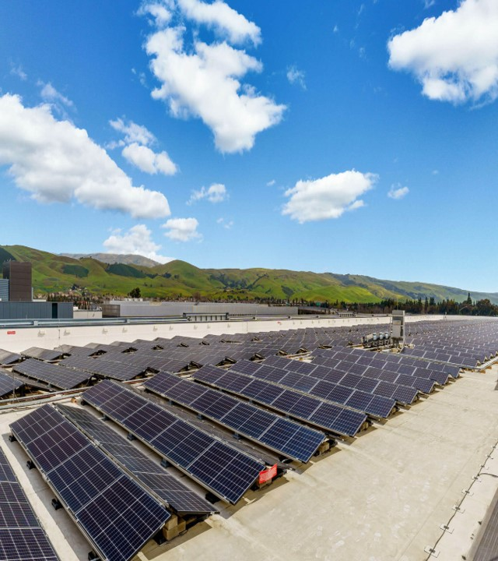
We’re protecting the planet
BUILD ON A DIGITAL FOUNDATION WITH 96% RENEWABLE ENERGY COVERAGE
    Committing to global climate neutrality and 100%
    renewable energy coverage by 2030.
    Investing $6.9 billion in green bonds toward sustainable
    building, energy efficiency and renewables.
    Reducing our absolute emissions by 24% since 2019,
    even amid business expansion.
    Designing for the environment with innovations like
    liquid cooling, heat recovery and low-carbon fuel cells.
  For our full sustainability report, visit
  sustainability.equinix.com.
Notes:
Our corporate sustainability program is comprised of environment, social and governance (ESG) initiatives that focus on material issues to positively impact our key stakeholders.
We are protecting our planet and climate through our environmental commitment to cover our global data center platform with 100% clean and renewable energy missions.
We were the first data center company to set a renewable energy goal back in 2015 and have hit over 90% renewables coverage every year since 2018. We reached 96% renewable energy coverage in 2022.
We drove the development of and were a founding signatory of the EU Climate Neutral Data Centre Operator Pact, an industry initiative to commit to EU data center carbon neutrality by 2030, to continue our momentum in climate change mitigation.
We have set near-term, science-based targets across our operational and supply chain emissions.
We are proud to have again been recognized as a leader in sustainability, receiving an A rating from CDP for second consecutive year, in addition to ranking #6 in the EPA’s Green Power Partnership National Top 100.
Since 2020, we issued $6.9B in green bonds committing to accelerating our efforts toward responsible building practices, energy efficiency and water conservation.
Equinix’s clean and renewable power includes 1063 MW of PPAs under long-term contract as of FY23.

Slide 28

We empower our people to make a positive impact
DIVERSITY, INCLUSION AND BELONGING
    Building a diverse and inclusive culture where every employee can say “I’m safe, I belong, and I matter.”
    Connecting talent to meaningful opportunities through workforce development.
    Partnering with organizations to advance digital inclusion.
    Enabling digital transformation of social impact and innovation centers.
Notes:
1 in 3 Equinix leaders are women, based on leadership & senior management roles (VP to Executive).
We have 9 Equinix employee resource groups:
WomenConnect, PrideConnect, BlackConnect, GenteConnect, interASIANconnect, VetConnect, FaithConnect, ProfessionalsConnect, ConnectAbilities
$50 million was contributed to establish the Equinix Foundation, an endeavor to provide funding and volunteer support to advance digital inclusion while also assessing opportunities related to environmental sustainability.
In 2023, we tracked $1.9 million of employee donations, corporate matching and grants, as well as 25,266 employee volunteer hours.
Through Equinix’s 2023 Impact Month, over 1,900 employees participated virtually and in person, raising over $282,000 (plus another $256,700 in WeGive Grants) and providing over 8,900 service hours. Our impact stretched across 619 causes, a 17% increase from the prior year.

Slide 29

We work as your trusted partner
FORWARD-THINKING GOVERNANCE STRATEGIES
    Ensuring 100% of employees complete Ethics
    & Compliance training for 10 years running.
    Aligning with evolving regional data privacy
    and security requirements.
    Influencing policies supporting the sustainable
    growth of the data center industry.
    Cultivating a responsible supply chain through
    supplier engagement and risk management.
    Spearheading the EU Climate Neutral Data Centre
    Pact to drive industrywide decarbonization.
Notes:
We power global trust and responsibility with governance strategies that ensure employee compliance with our Code of Business Conduct; address evolving business requirements, including the EU’s General Data Protection Regulations; and advocating for progress on clean, renewable energy and resilience of the electric power sector, which is critical to Equinix’s operations.
8 of 12 Equinix board members are independent (not company employees). 4 board members are women.
Equinix meets the requirements of the European Union (EU)’s General Data Protection Regulation (GDPR).
Code of Business Conduct and Anti-Bribery and Corruption trainings reach 100% of employees worldwide.
Equinix does not make political contributions and does not have a Political Action Committee (PAC).

Slide 30













Innovate with digital infrastructure committed to sustainability
Multiply your impact
Develop and offer products and services that let your customers meet sustainability goals.
Deliver Sustainability
as a Service
Choose like-minded partners
The power of choice
Gain the most efficient access to the largest ecosystems and marketplaces powered by like-minded leaders.
Build your foundation
sustainably
Sustainability-ready at scale
Overcome barriers by accessing a global infrastructure platform committed to sustainability.
Notes:
80%+ of the Forbes Top 100 Digital Companies have leveraged Platform Equinix® to implement and capitalize on their digital-first strategies sustainably. 1 in 2 leaders on top sustainability rankings* partner with Equinix.
—*based on customers that were ranked in CDP’s A-list and Corporate Knights’ top 100 most sustainable companies in 2023.

Slide 31
Customer case studies

Slide 32
We’ve partnered with Equinix to be able to deliver a hub-and-spoke architecture, which allows for us to move data and applications from one region to another into our enterprise data warehouse so we can do analytics. It has been a very positive thing from a guest experience because now I’m able to deliver more close, in-region applications and data.”
  Eric Norman
    Head of Infrastructure Architecture and Innovation
    IHG

Slide 33
Customer challenge
  IHG needed to improve its IT infrastructure to enhance the modern traveler experience through a personalized end-to-end service, which required migrating the legacy data center environment and moving all public cloud and SaaS providers into the Equinix Performance Hub®.
Results
  IHG gained a faster service time to market, with
  infrastructure that is easy to set up and scale without
  vendor lock-in.
Platform Equinix®
  Leveraging low-latency private multicloud connectivity and Network Edge, Platform Equinix enabled the movement of all IHG’s public cloud and SaaS providers to the Equinix Performance Hub.

Slide 34
When we look at our own data centers versus operating in Equinix or operating in the cloud, frankly, the economy of scale that exists for Equinix and the cloud providers is beyond what we could achieve on our own. So we immediately benefit from the sustainability efforts of Equinix, our cloud providers and our partners.”
  Kelly Shubert
    Senior Director of Core Technologies
    Air Canada

Slide 35
Customer challenge
  Air Canada wanted to enable a frictionless experience while connecting with a complex ecosystem of external partners to serve passengers from 100 countries in 180 airports around the world.
Results
  Air Canada achieved a quicker service time to market, got seamless connectivity with external partners and developed new customer experiences using modern tools such as AI, machine learning and virtual reality.
Platform Equinix®
  Platform Equinix helped Air Canada to optimize and modernize its network, adapting to the growing level of connectivity among systems, passengers, security, customs, retail, freight, hotels and other services.
  Real-time connectivity and a secure, robust digital infrastructure proved critical for travellers to enjoy
  a seamless, personalized travelling experience.
Equinix Fabric®
  Equinix Fabric enables localized delivery of multiple cloud-supported services through scalable, virtualized connections.

Slide 36
At Stadler, we are going through a digital transformation.
The aim of this completely renewed environment is to increase the efficiency of the entire value chain. Partnering with Equinix has given us a future-proof digital infrastructure platform that we can innovate and expand on.”
  Michael Hutab
    Chief Information Officer
    Stadler

Slide 37
Customer challenge
  The distributed local data center model hindered the company’s ability to efficiently share business-critical applications
  among global users and quickly expand its production
  of customized trains. Stadler also needed corporate data
  centers that would be resilient in the face of climate issues and unreliable infrastructure.
Results
  Stadler achieved improved uptime from 99.00% to 99.99% with no outages and a 10x increase in on-demand bandwidth speeds.
Platform Equinix®
  Equinix’s global digital infrastructure platform gave
  Stadler the flexibility to plan more effectively for the future,
  adopting innovative digital technologies and quickly bringing to market new tailor-made manufacturing services and locations.
  The company expanded to new regions across a sustainable, global platform without purchasing hardware.

Slide 38
Harrison.ai is tackling some of the biggest issues causing
inequitable diagnosis and treatment today with rapidly developed
AI products in chest X-rays and brain computed tomography
scans…to develop customized AI-enabled tools…Harrison.ai deployed its DGX A100 systems on Platform Equinix®...”
  Dr. Aengus Tran
    CEO and Co-founder
    Harrison.ai

Slide 39
Customer challenge
  Harrison.ai needed scalable digital infrastructure to support the development of AI-enabled tools for chest X-ray diagnosis. The company required infrastructure with the capacity to run compute-intensive machine learning (ML) on multiple NVIDIA DGX A100 systems.
Results
  The company saw an 8x increase in data processing capability. ML could complete, in mere months, tasks that would have taken a single radiologist 40 years.
Platform Equinix®
  Equinix SY5 Sydney IBX® data center hosted eight DGX A100 systems to enable all the analytics, scientific computing and AI development necessary to reduce model training time and speed up the ML process.

